Slide 1
Re-Imagine Your HCP Advertising

Slide 2
Summary
Health Data
HCP Segment Targeting
TV Activation
Case Study

Slide 3

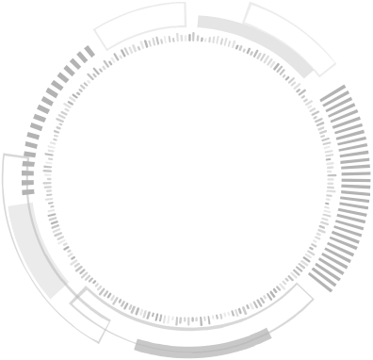


Patient 38393
300 Million Unique De-Identified Patients
10 years of granular level longitudinal data refreshed weekly
Dx, Rx, CPT and J-Code as well as NPI for Each Claim
Patient 59291
Patient 4431
Patient 987
Patient 995
Patient 7823
Patient 3856
Patient 33939
Our system transforms real world data into precise patient audiences
Patient 8729
Patient 422
Artificial Intelligence
Data unification
Patient 5942
Machine learning
Patient 46852
Patient 4325
Patient 8682
SWOOP DATA UNIVERSE
Patient 99853
Patient 6685
Exclusive Target Audience of Ideal Patients
Patient 9985
Patient 78235
Patient 5265
Patient 648235
Patient 3382
Patient 77431
Patient 8735
Patient 664
65 Billion Anonymous
Consumer Attributes
Representing over 3,100 consumer segments
Patient 214782
Patient 89354

Slide 4
Target List Match 70% match rate
Specialty, Treating & Prescribing
Veraspec Looks at what Physicians DO rather than declare
Influencer Physicians likely to influence other Physicians
Competitors, Decision Makers or Switchers
Adherence & Access
Custom HCP / NPI Segments based on unique brand objectives & agreed upon business rules
Notes:
NPI List
Above the mean 50% percentile then constantly evaluate against the lower 50%

Slide 5







Ideal HCP Engagement
Deliver your message to verified HCPs in their preferred social networks.
The only DSP-agnostic HCP targeting with PLD reporting.
Message HCPs in the clinical workflow with follow-up
next-best-action engagement.
Email
Social Media
Television
Programmatic
Point-of-Care
EHRs
Congresses
Engage HCPs with an affinity for email and trigger next best action based on engagement.
The first HCP TV advertising solution scaled across ATV, CTV and OTT.
Reach HCPs on their handheld devices while at the point of care.
Mobile/tablet messaging delivered to HCPs attending congresses and meetings.

Slide 6








Television
The first HCP TV advertising solution scaled across addressable TV and connected TV/OTT.
Access over 1.6M verified HCP households and
affiliated devices.
Apply the same audience used in digital channels for TV planning and activation to optimize reach and frequency.

Slide 7



Optimizing HCP Engagement
Determined by preferred channel and behavior including while at the point of care and in the EHR.
Swoop Creates Value By:
Providing Exclusive HCP Segments
Based on client’s market definitions, strategies and goals, rather than treating all HCPs equally.
Understanding HCP Preferences
By uncovering content consumption patterns and the creative they are most likely to engage with.

Slide 8


Case Study: Delivering 12:1 ROI
for a Leading Neurological Movement Disorder Therapy
The Challenge
The Solution
The Outcome
Increase brand awareness among HCPs treating tardive dyskinesia - particularly those writing competitive treatments and practicing in low-access priority office locations.
Swoop activated hard-to-reach professionals through connected TV (CTV), serving a :60 promotion to target HCP households through NPI-to-device matching.
A 10% script lift leading to an incremental 130 new-to-brand starts in five months, delivering nearly $900,000 in incremental lifetime patient value - a 12:1 ROI.

Slide 9





Our Industry Footprint
6,000+ Exclusive Segments
42 of Top 50 Pharma
Brands
18 of Top 20 Healthcare Agencies

Slide 10

THANK YOU
Swoop (www.swoop.com), part of Real Chemistry, empowers the world’s leading pharmaceutical brands to better-educate patients about disease states and the therapies that could remedy their conditions, as well as enable them to become active participants in their treatment journey. Swoop’s HIPAA-certified and NAI-accredited system of engagement has uncovered over 6,000 unique target audiences for precisely activating patient populations and their healthcare ecosystems through omnichannel marketing strategies. By utilizing artificial intelligence, machine learning and evolutionary computation in conjunction with a real world data universe of over 300 million de-identified patients, 65 billion anonymized social determinants of health signals and 1.6 million healthcare provider profiles, Swoop’s segments are superior in audience quality, lead to optimal conversion and drive increased Rx lift. It’s no wonder that 18 of the top 20 healthcare marketing agencies and 42 of the top 50 pharmaceutical companies power their marketing efforts with Swoop. And we are just getting started.

